Slide 1
On-Line Analytical Processing
On-Line Analytical Processing (OLAP) is an advanced data analysis environment that supports decision making, business modeling, and operations research activities.
Describes a technology that is designed to optimize the storing and querying of large volumes of multi-dimensional data that is aggregated (summarized) to various levels of detail to support the analysis of this data.
OLAP is a category of s/w technology that enables analyst , manager and executives to gain insights into data through fast ,consistent ,interactive access in a wide variety of possible views of information that has been transformed from raw data to reflect the real dimensionality of the enterprise as understood by the user
Allows users to view corporate data in such a way that it is a better model of the true dimensionality of the enterprise.
Notes:
‹#›
23

Slide 2
Four Main Characteristics of OLAP
Use multidimensional data analysis techniques
Provide advanced database support
Provide easy-to-use end user interfaces
Support client/server architecture

Slide 3
On-Line Analytical Processing
Multidimensional Data Analysis Techniques
The processing of data in which data are viewed as part of a multidimensional structure.
Multidimensional view allows end users to consolidate or aggregate data at different levels.
Multidimensional view allows a business analyst to easily switch business perspectives.
Figure 13.4
Notes:
‹#›
24

Slide 4
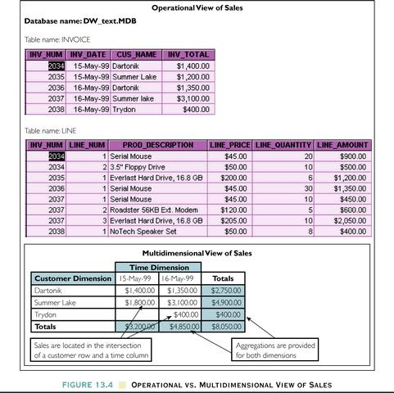
Operational Vs. Multidimensional View Of Sales

Slide 5
On-Line Analytical Processing
Additional Functions of Multidimensional Data Analysis Techniques
Advanced data presentation functions
Advanced data aggregation, consolidation, and classification functions
Advanced computational functions
Advanced data modeling functions
Notes:
‹#›
26

Slide 6
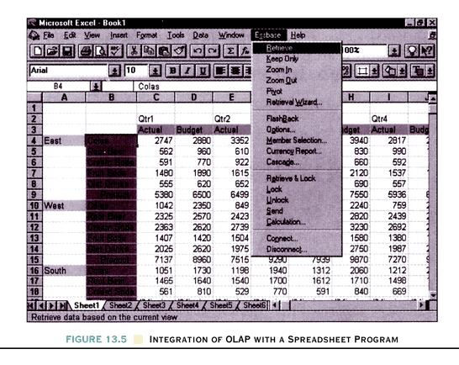
Integration Of OLAP With A Spreadsheet Program

Slide 7
On-Line Analytical Processing
Advanced Database Support
Access to many different kinds of DBMSs, flat files, and internal and external data sources.
Access to aggregated Data Warehouse data as well as to the detail data found in operational databases.
Advanced data navigation features such as drill-down and roll-up.
Rapid and consistent query response times.
The ability to map end user requests, expressed in either business or model terms, to the appropriate data source and then to the proper data access language.
Support for very large databases.
Notes:
‹#›
28

Slide 8
On-Line Analytical Processing
Easy-to-Use End User Interface
Easy-to-use graphical user interfaces make sophisticated data extraction and analysis tools easily accepted and readily used.
Client/Server Architecture
The client/server environment enables us to divide an OLAP system into several components that define its architecture.
Notes:
‹#›
29

Slide 9
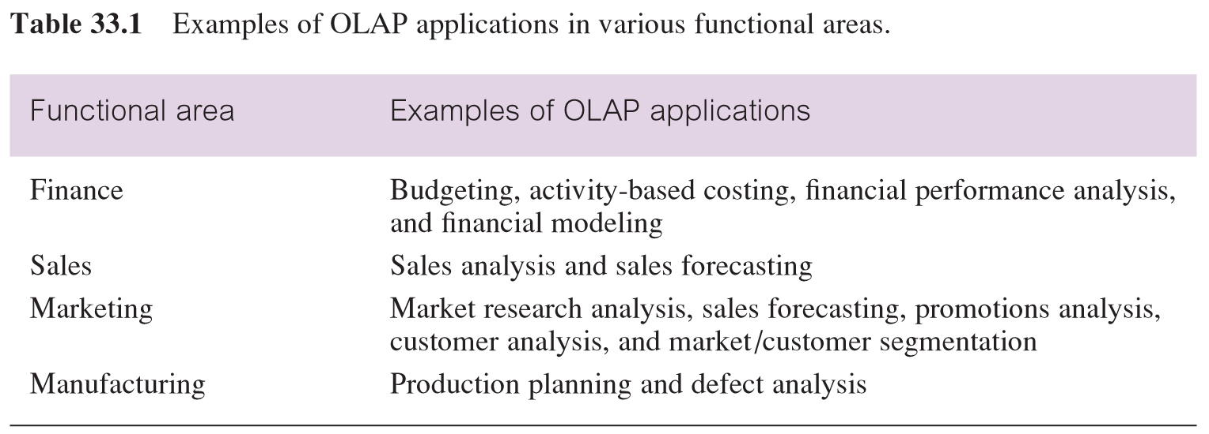
Examples of OLAP applications in various functional areas
‹#›

Slide 10
OLAP Applications
Although OLAP applications are found in widely divergent functional areas, they all have the following key features:
multi-dimensional views of data
support for complex calculations
time intelligence
‹#›

Slide 11
Benefits of OLAP:
Enables analyst, executives, and managers to gain useful insights from the presentation of the data.
Can reorganize metrics along several dimensions and allow data to be viewed with respect to different dimensions.
Supports multidimensional analysis.
It able to drill down and rollup within each dimension.
Is capable to apply mathematical formulas and calculations to measures.
Provides fast response.
Designed for highly interactive analysis.

Slide 12
Multi-dimensional Data and OLAP cubes
Multi-dimensional data is facts (numeric measurements) such as property sales revenue data and the association of this data with dimensions such as location (of the property) and time (of the property sale).
‹#›

Slide 13
OLAP Cubes
An OLAP Cube is a data structure that allows fast analysis of data according to the multipleDimensions that define a business problem.
An OLAP cube is a data structure that overcomes limitations of relational databases by providing rapid analysis of data.
OLAP cubes can display and sum large amounts of data while also providing users with searchable access to any data points so that the data can be rolled up, sliced, and diced as needed to handle the widest variety of questions that are relevant to a user’s area of interest.
A multidimensional cube for reporting sales might be, for example, composed of 6 Dimensions: Salesperson, Region, Product, Region, Month, Year.

Slide 14
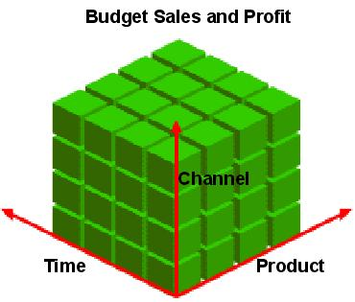
OLAP CUBE - Dimensional modeling
‹#›
Notes:
‹#›

Slide 15
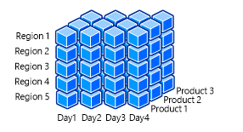

Slide 16
Conceptual Modeling of Data Warehouses
Modeling data warehouses: dimensions & measures
Star schema: A fact table in the middle connected to a set of dimension tables
Snowflake schema: A refinement of star schema where some dimensional hierarchy is normalized into a set of smaller dimension tables, forming a shape similar to snowflake
Fact constellations: Multiple fact tables share dimension tables, viewed as a collection of stars, therefore called galaxy schema or fact constellation
‹#›
Notes:
‹#›

Slide 17
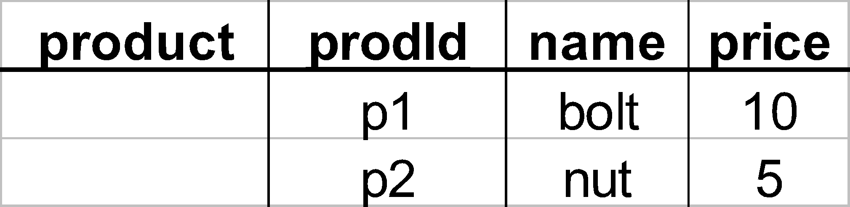
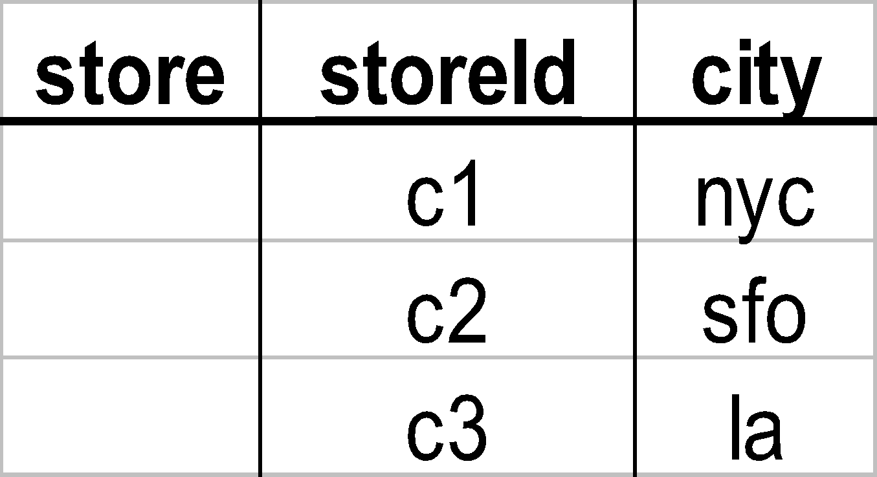
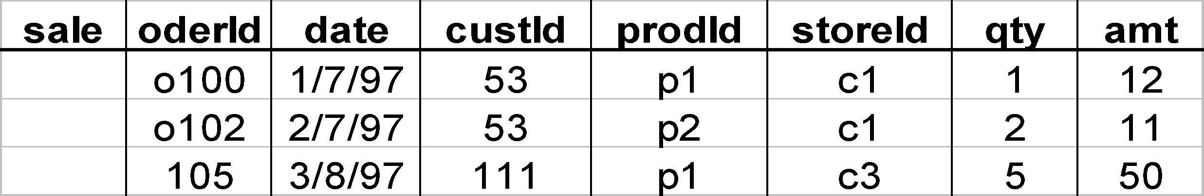
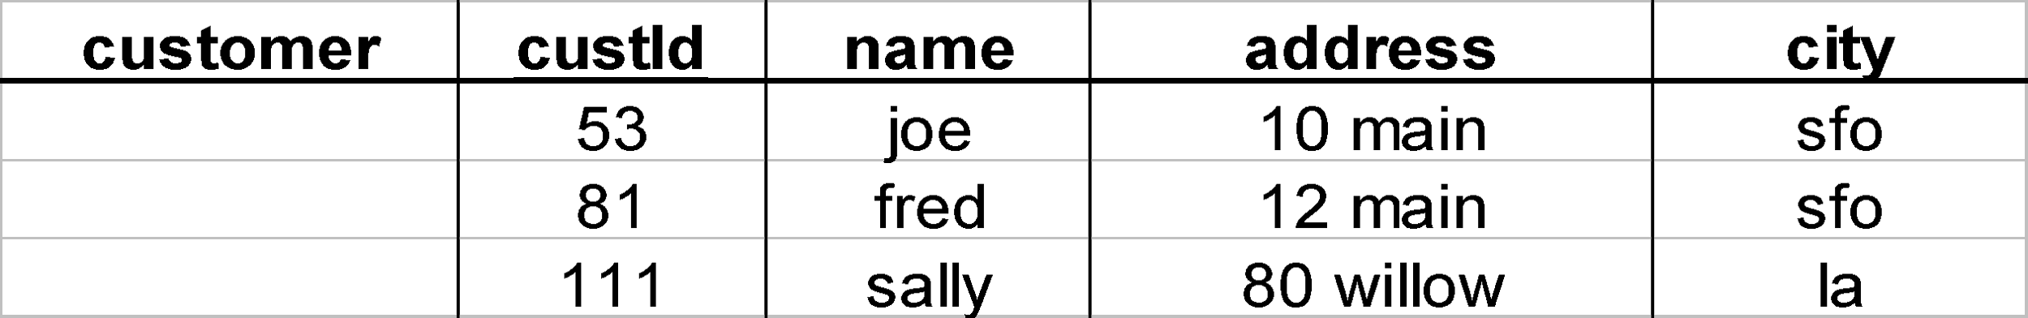
Star
‹#›

Slide 18
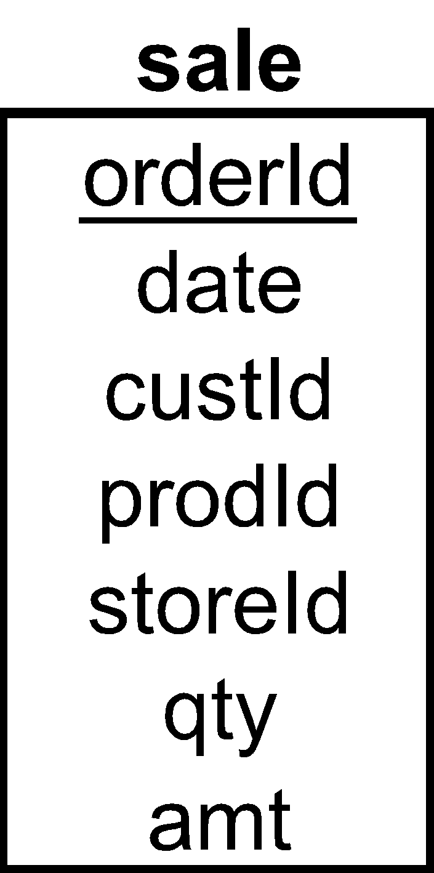
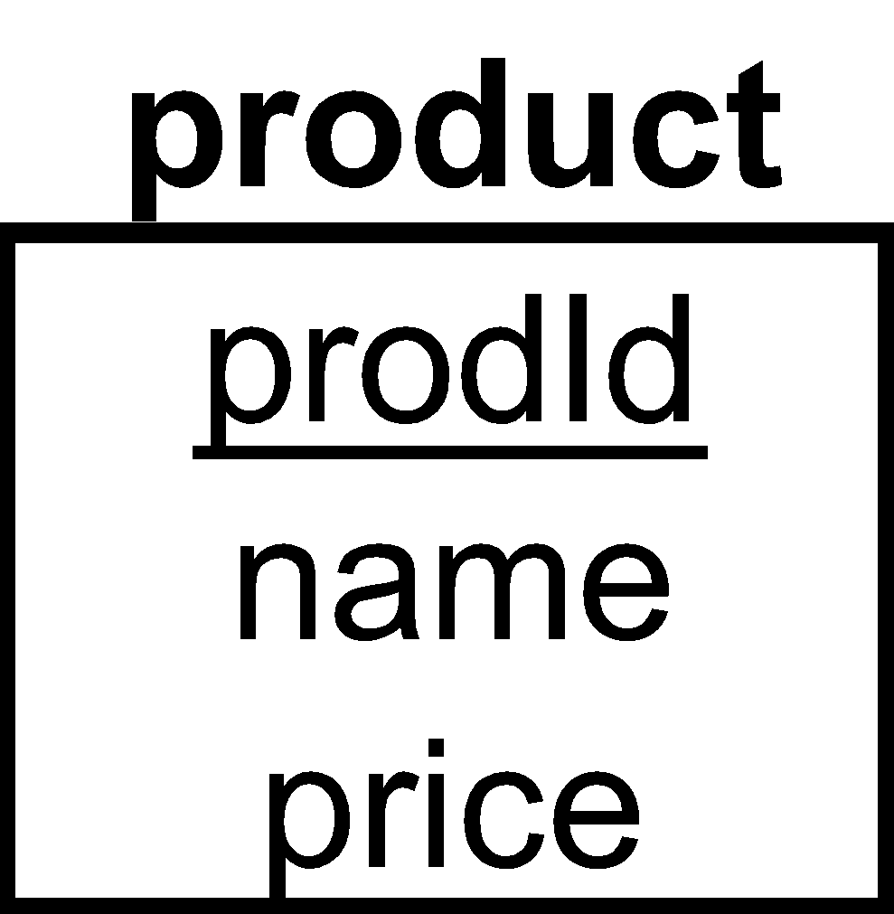
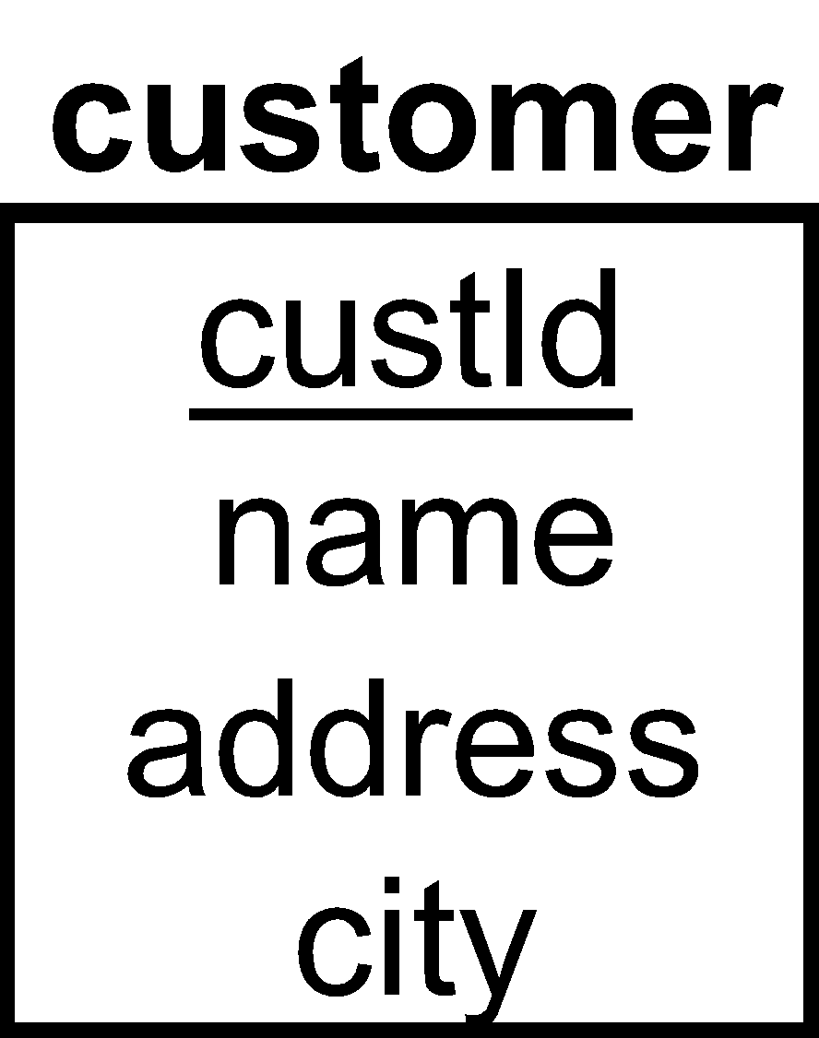
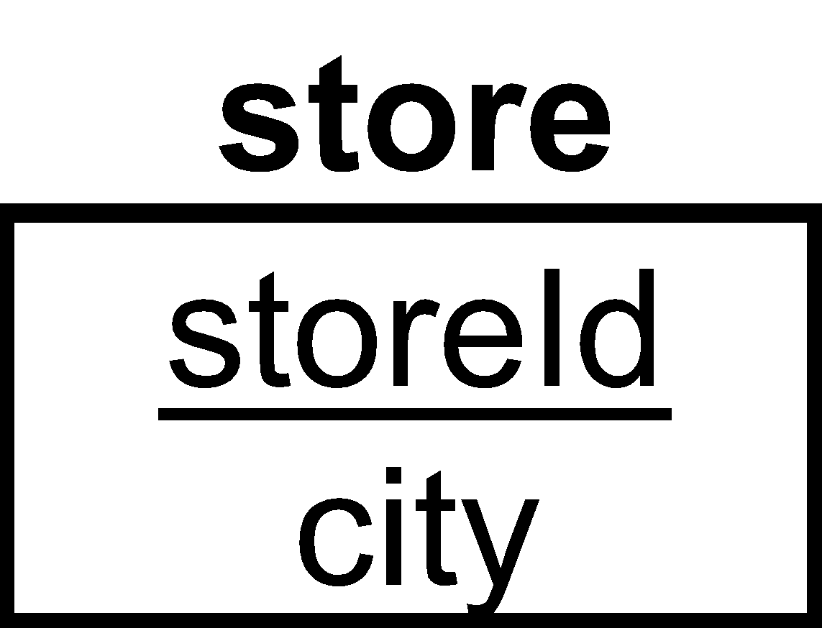
Star Schema
‹#›

Slide 19
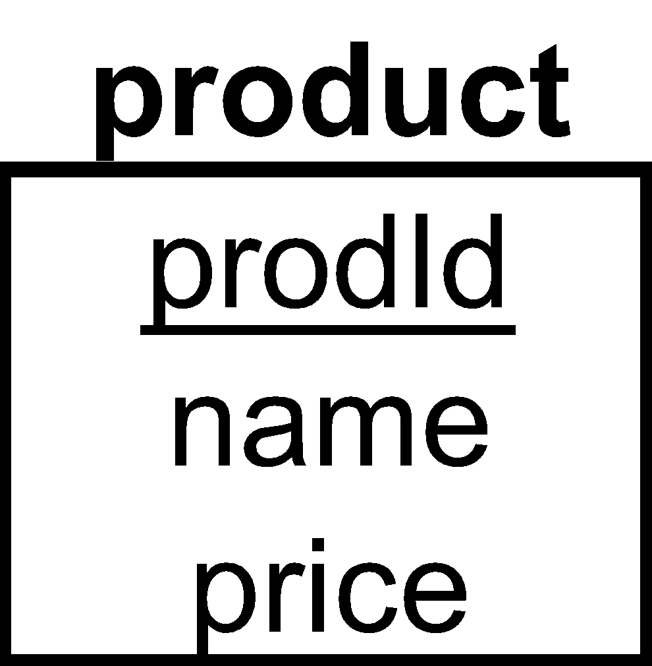
Terms
Fact table
Dimension tables
Measures
‹#›

Slide 20
Another Star Schema
time
time_key
day
day_of_the_week
month
quarter
year
item
item_key
item_name
brand
type
supplier_type
Sales Fact Table
time_key
item_key
branch_key
branch
location
location_key
branch_key
branch_name
branch_type
location_key
street
city
province_or_street
country
units_sold
dollars_sold
avg_sales
Measures
‹#›

Slide 21
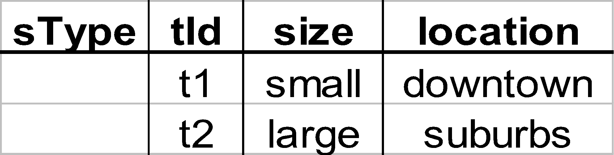
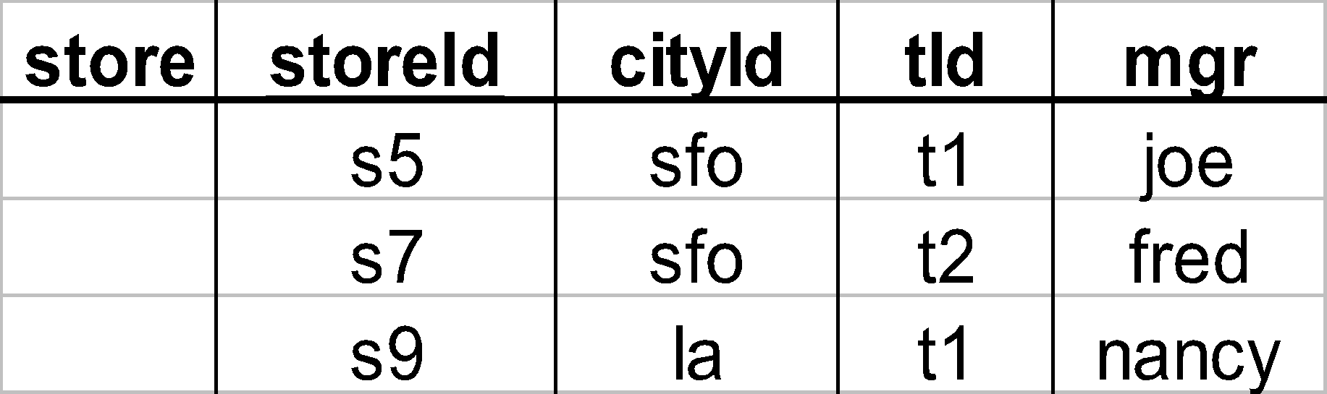
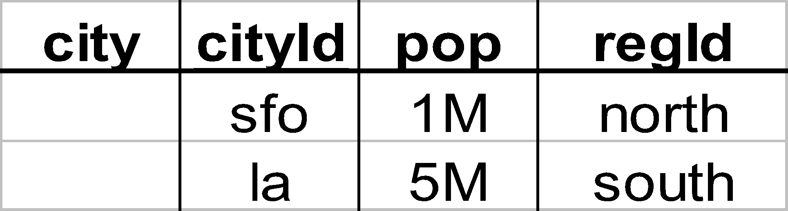
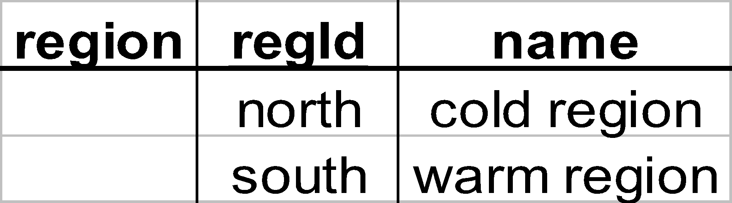
Dimension Hierarchies
sType
store
city
region
🡺 snowflake schema
🡺 constellations
‹#›

Slide 22
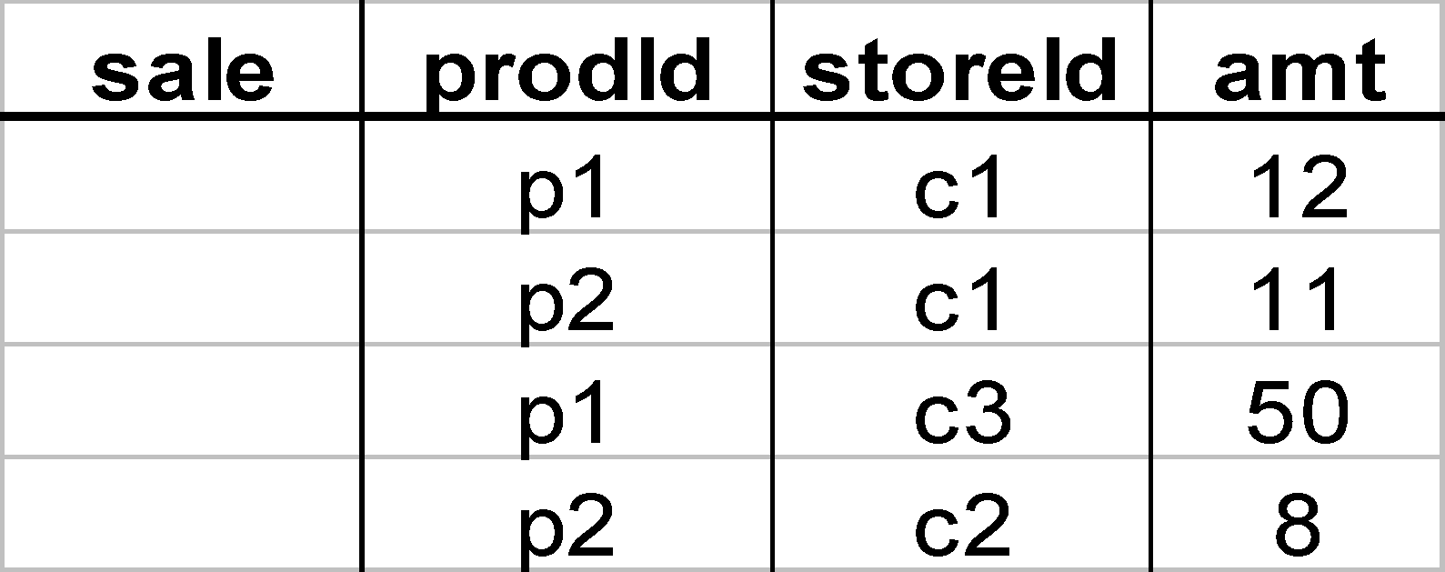
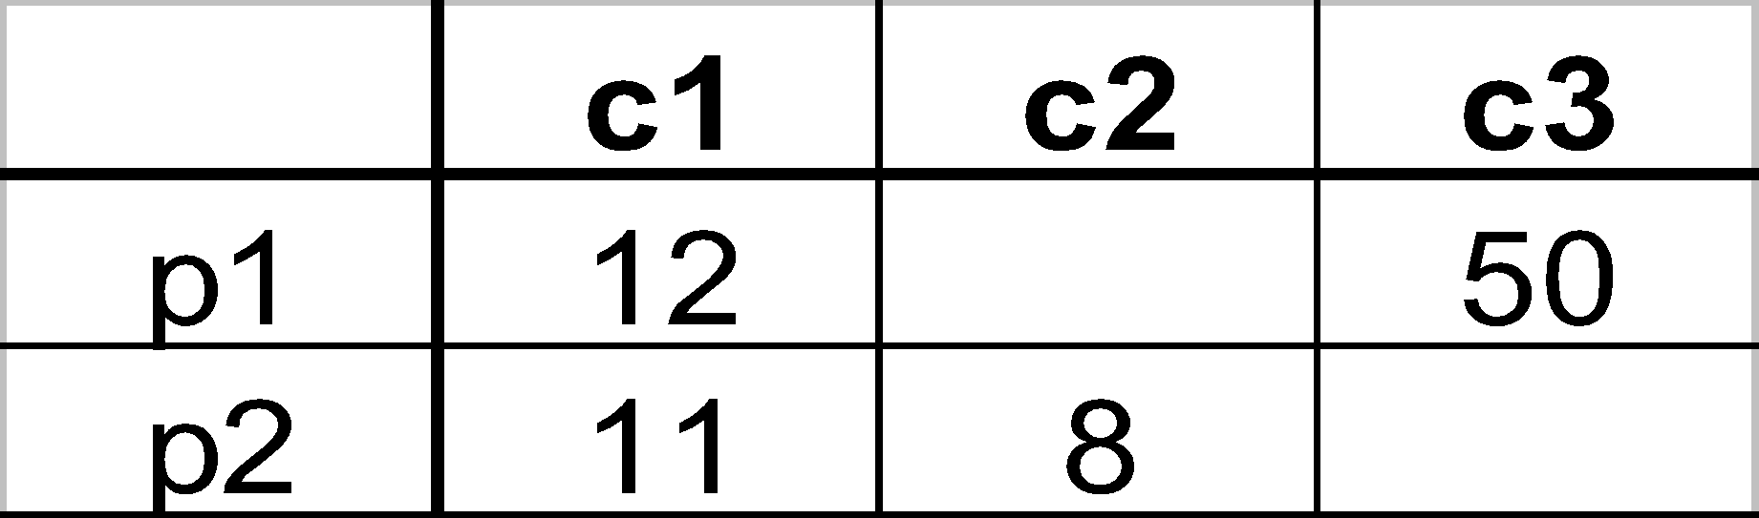
Cube
Fact table view:
Multi-dimensional cube:
dimensions = 2
‹#›

Slide 23
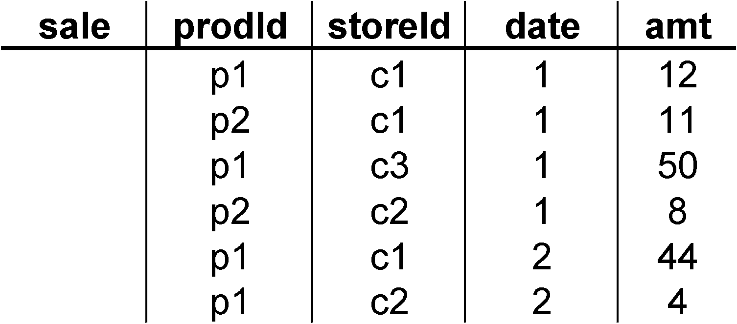
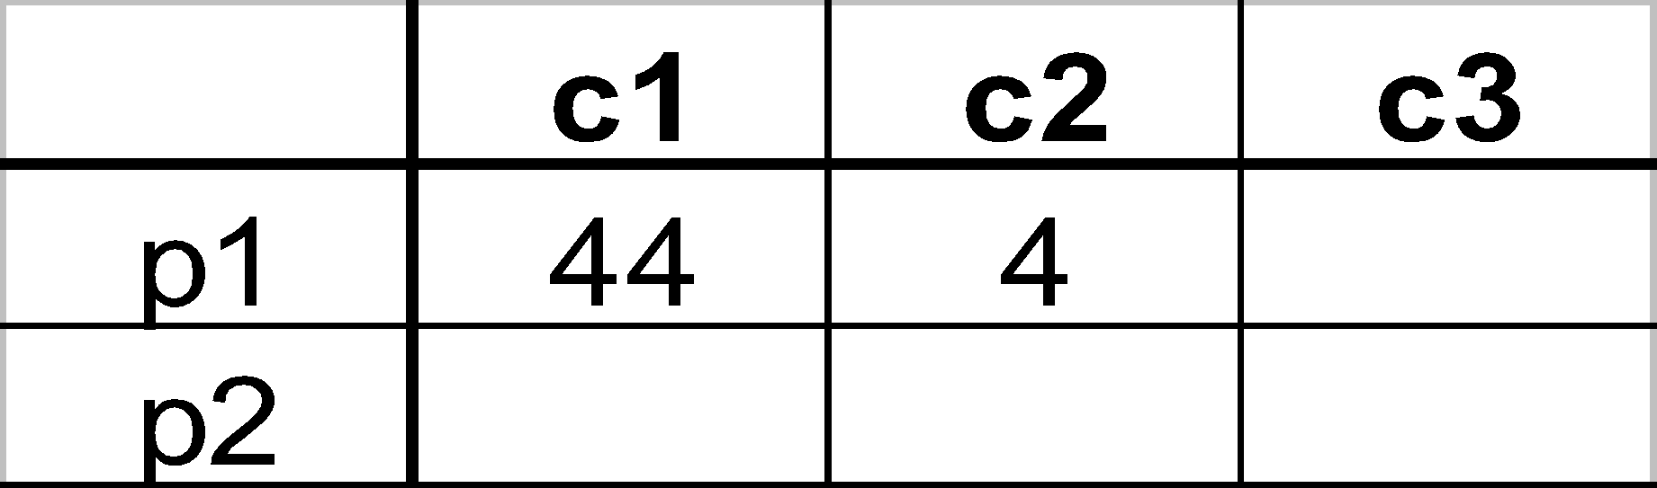
3-D Cube
Fact table view:
Multi-dimensional cube:
day 2
day 1
dimensions = 3
‹#›

Slide 24
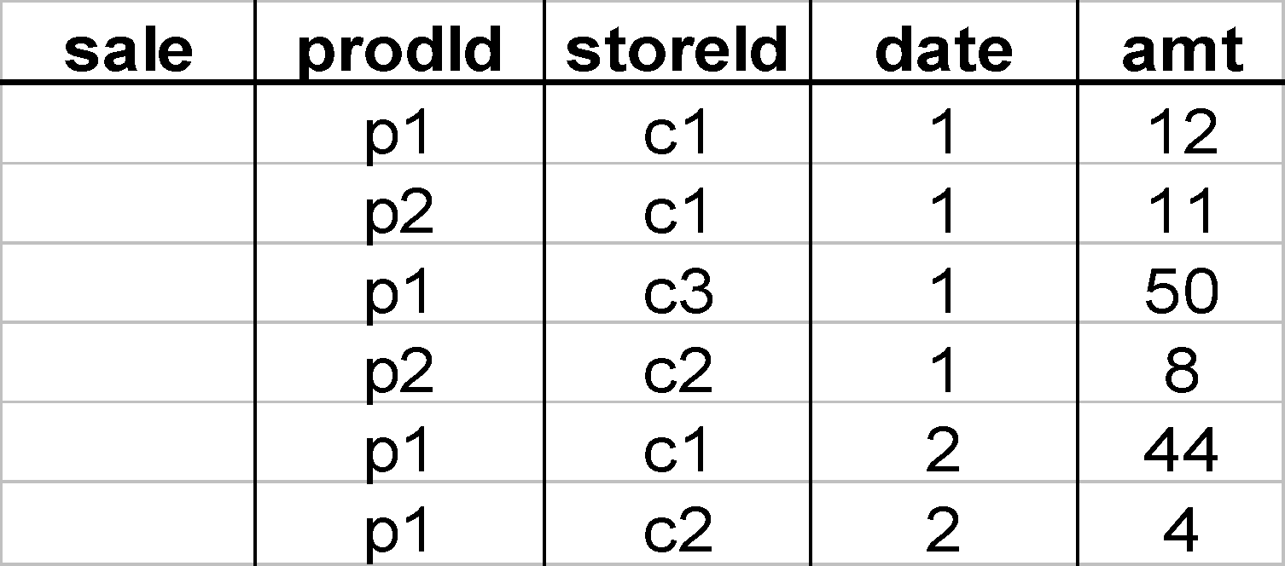
Aggregates
Add up amounts for day 1
In SQL: SELECT sum(amt) FROM SALE
WHERE date = 1
81
‹#›

Slide 25
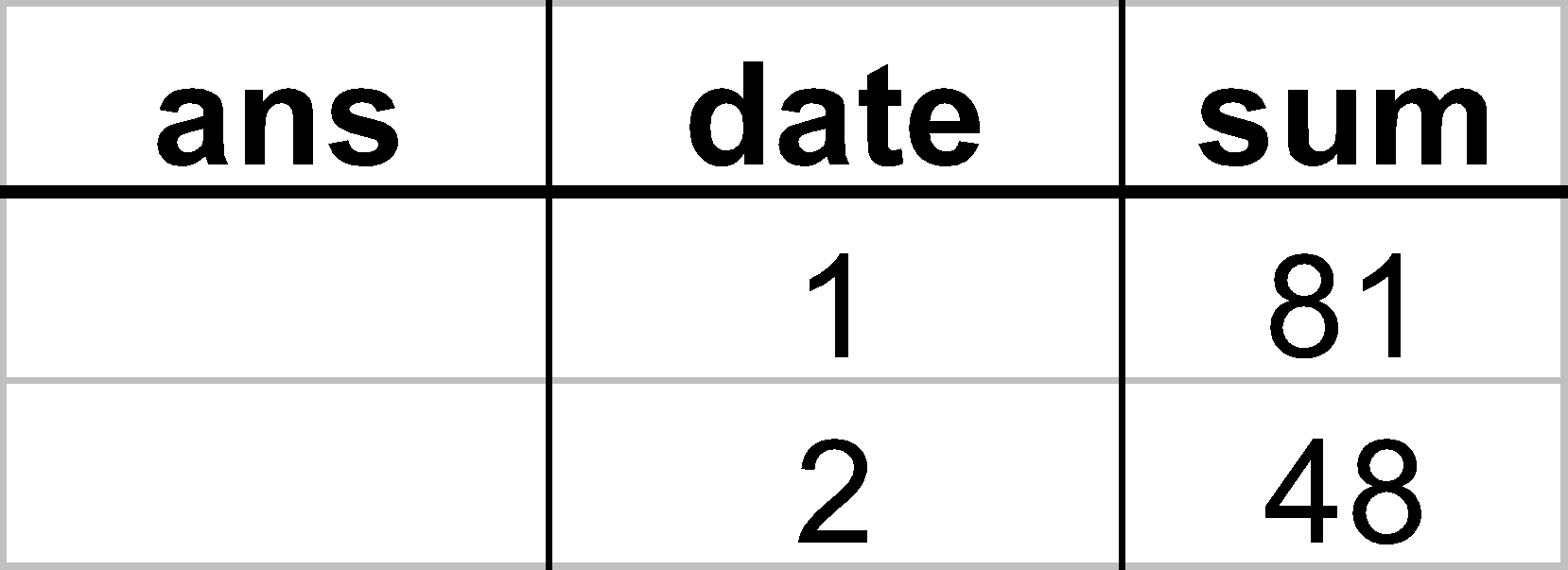
Aggregates
Add up amounts by day
In SQL: SELECT date, sum(amt) FROM SALE
GROUP BY date
‹#›

Slide 26
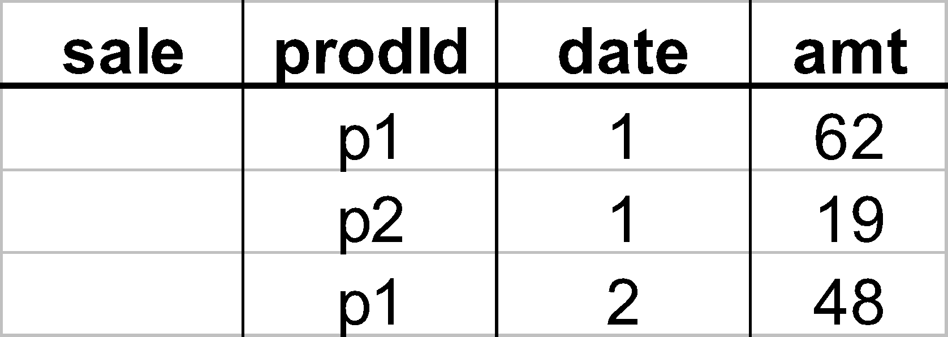
Another Example
Add up amounts by day, product
In SQL: SELECT date, sum(amt) FROM SALE
GROUP BY date, prodId
rollup
drill-down
‹#›

Slide 27
Aggregates
Operators: sum, count, max, min, avg
“Having” clause
Using dimension hierarchy
average by region (within store)
maximum by month (within date)
‹#›

Slide 28
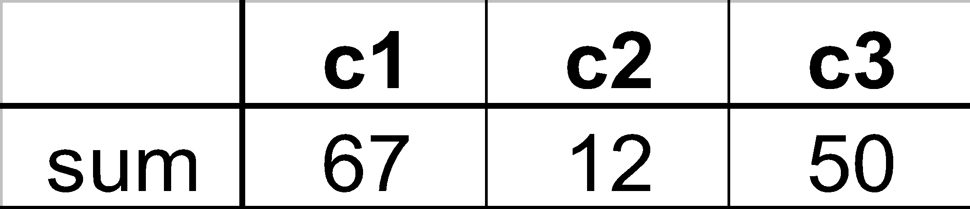
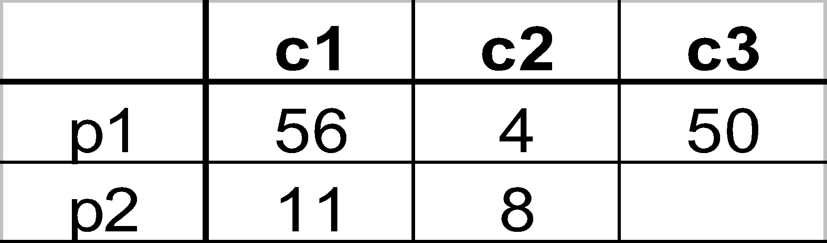
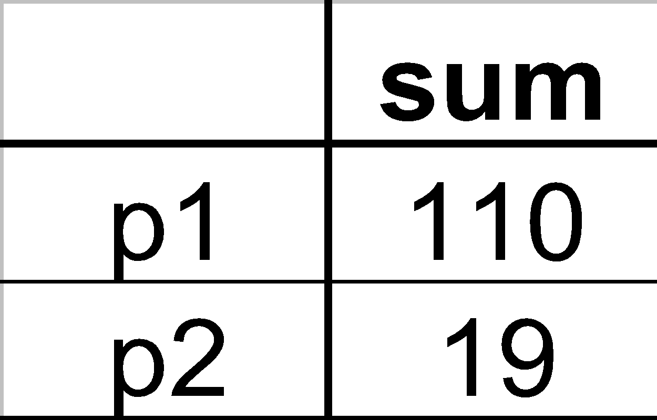
Cube Aggregation
Example: computing sums
day 2
. . .
day 1
129
rollup
drill-down
‹#›

Slide 29
Cube Operators
day 2
. . .
day 1
sale(c1,*,*)
129
sale(c2,p2,*)
sale(*,*,*)
‹#›

Slide 30
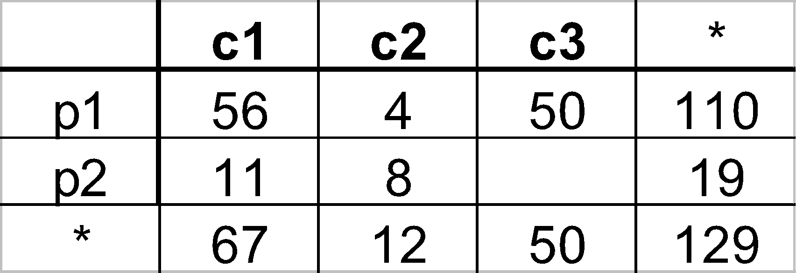
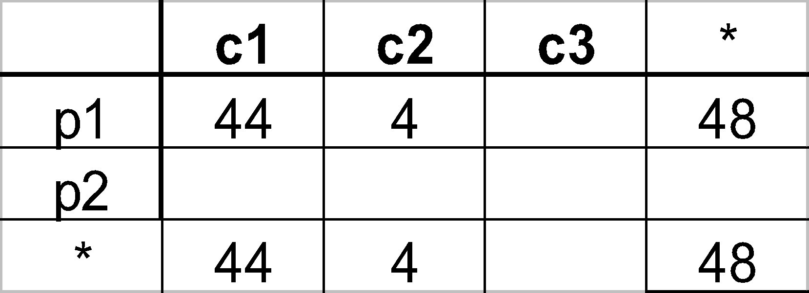

Extended Cube
*
day 2
sale(*,p2,*)
day 1
‹#›

Slide 31
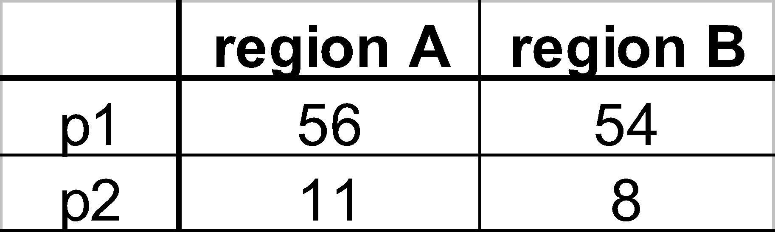
Aggregation Using Hierarchies
day 2
customer
day 1
region
country
(customer c1 in Region A;
customers c2, c3 in Region B)
‹#›

Slide 32
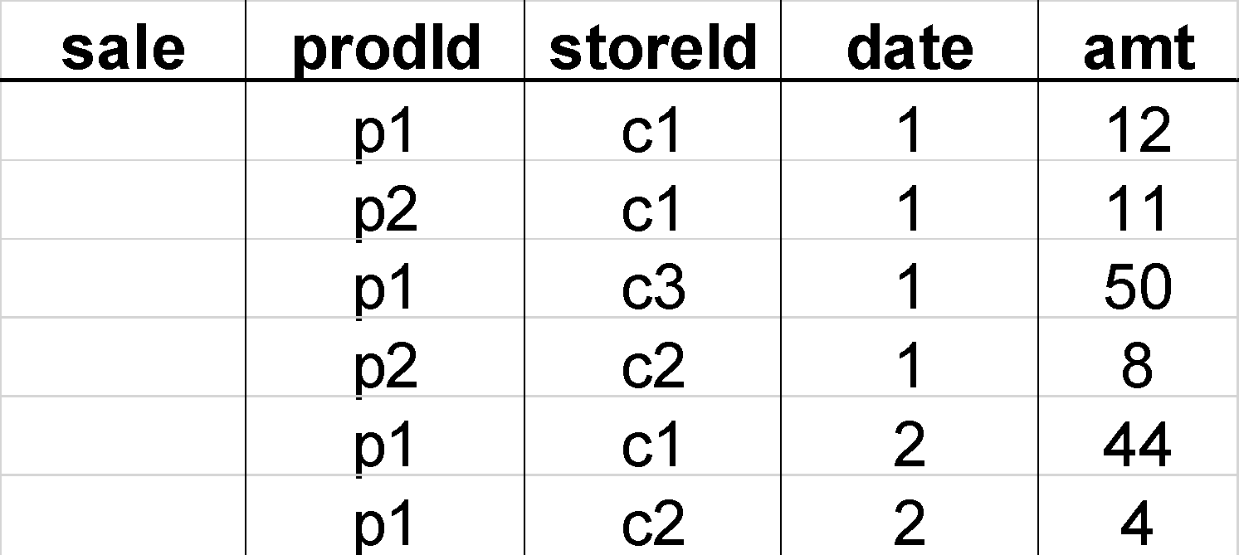
Pivoting
Fact table view:
Multi-dimensional cube:
day 2
day 1
‹#›

Slide 33
What is Online Analytical Processing?
OLAP is a category of software that allows users to analyze information from multiple database systems at the same time.
It is a technology that enables analysts to extract and view business data from different points of view.
Analysts frequently need to group, aggregate and join data.
These operations in relational databases are resource intensive.
With OLAP data can be pre-calculated and pre-aggregated, making analysis faster.
OLAP databases are divided into one or more cubes.
The cubes are designed in such a way that creating and viewing reports become easy.

Slide 34
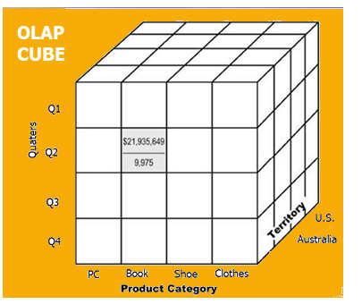
OLAP cube:

Slide 35
At the core of the OLAP, concept is an OLAP Cube.
The OLAP cube is a data structure optimized for very quick data analysis.
The OLAP Cube consists of numeric facts called measures which are categorized by dimensions. OLAP Cube is also called the hypercube.
Usually, data operations and analysis are performed using the simple spreadsheet, where data values are arranged in row and column format.
This is ideal for two-dimensional data.
However, OLAP contains multidimensional data, with data usually obtained from a different and unrelated source. Using a spreadsheet is not an optimal option.
The cube can store and analyze multidimensional data in a logical and orderly manner.

Slide 36
How does it work?
A Data warehouse would extract information from multiple data sources and formats like text files, excel sheet, multimedia files, etc.
The extracted data is cleaned and transformed.
Data is loaded into an OLAP server (or OLAP cube) where information is pre-calculated in advance for further analysis.

Slide 37
Basic analytical operations of OLAP
Four types of analytical operations in OLAP are:
Roll-up
Drill-down
Slice and dice
Pivot (rotate)

Slide 38
1) Roll-up:
Roll-up is also known as "consolidation" or "aggregation."
The Roll-up operation can be performed in 2 ways
Reducing dimensions
Climbing up concept hierarchy. Concept hierarchy is a system of grouping things based on their order or level.

Slide 39
OLAP Operations:
Roll-up
Takes the current aggregation level of fact values and does a further aggregation on one or more of the dimensions.
Equivalent to doing GROUP BY to this dimension by using attribute hierarchy.

Slide 40
SELECT [attribute list], SUM [attribute names] FROM [table list] WHERE [condition list] GROUP BY [grouping list];

Slide 41
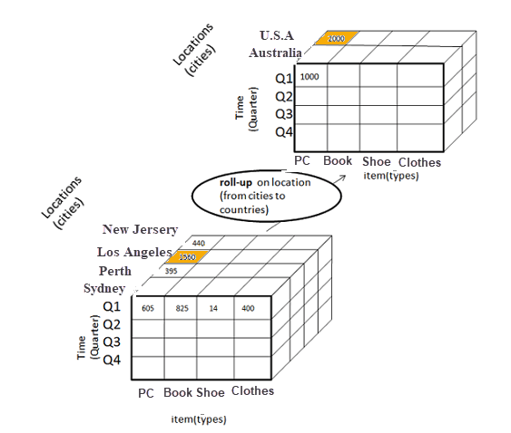
Consider the following diagram
In this example, cities New jersey and Lost Angles and rolled up into country USA
The sales figure of New Jersey and Los
Angeles are 440 and 1560 respectively.
They become 2000 after roll-up
In this aggregation process, data is location
hierarchy moves up from city to the
country.
In the roll-up process at least one or more dimensions need to be removed. In this example, Quarter dimension is removed.

Slide 42
Drill-down
Opposite of roll-up.
Summarizes data at a lower level of a dimension hierarchy, thereby viewing data in a more specialized level within a dimension.
Increases a number of dimensions - adds new headers

Slide 43
2) Drill-down
In drill-down data is fragmented into smaller parts. It is the opposite of the rollup process. It can be done via
Moving down the concept hierarchy
Increasing a dimension

Slide 44
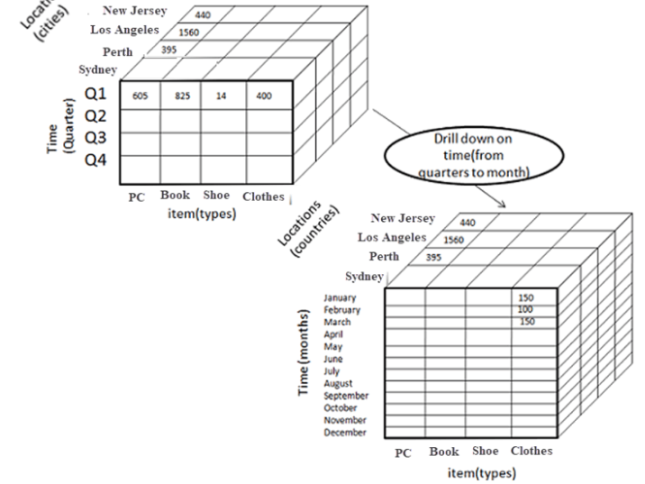
Quarter Q1 is drilled down to months January, February, and March.
Corresponding sales are also registers.
In this example, dimension months are added.

Slide 45
Slice
Performs a selection on one dimension of the given cube, resulting in a sub-cube.
Reduces the dimensionality of the cubes.
Sets one or more dimensions to specific values and keeps a subset of dimensions for selected values.
Dice
Define a sub-cube by performing a selection of one or more dimensions.
Refers to range select condition on one dimension, or to select condition on more than one dimension.
Reduces the number of member values of one or more dimensions.

Slide 46
Slice:
Here, one dimension is selected, and a new sub-cube is created.
Following diagram explain how slice operation performed:
Dimension Time is Sliced with Q1 as the filter.
A new cube is created altogether.
The main difference between slice and dice in data warehouse is that the slice is an operation that selects one specific dimension from a given data cube and provides a new subcube while the dice is an operation that selects two or more dimensions from a given data cube and provides a new subcube.

Slide 47
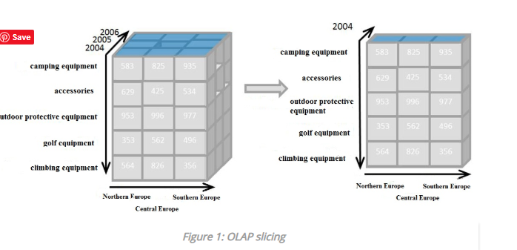

Slide 48
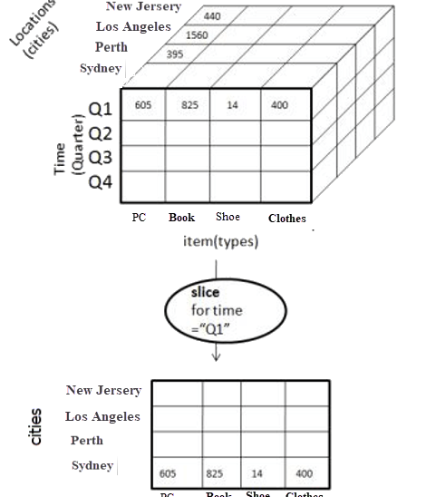

Slide 49
Dice:
This operation is similar to a slice. The difference in dice is you select 2 or more dimensions that result in the creation of a sub-cube.

Slide 50
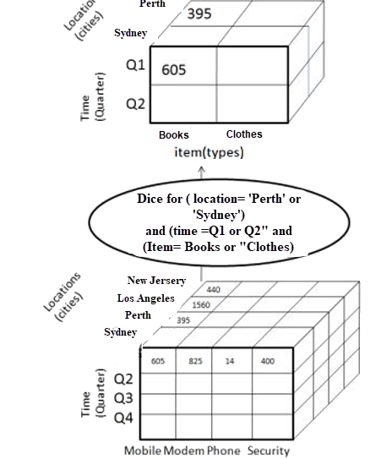

Slide 51
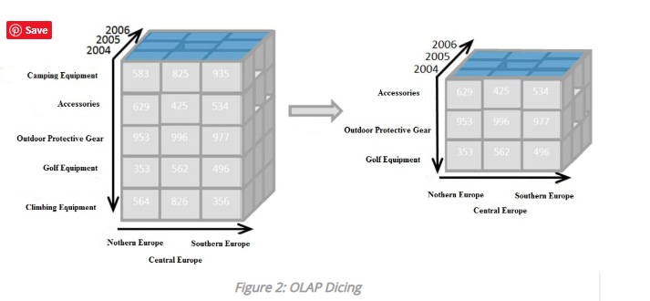

Slide 52
4) Pivot
In Pivot, you rotate the data axis to provide a substitute presentation of data.
In the following example, the pivot is based on item types.

Slide 53
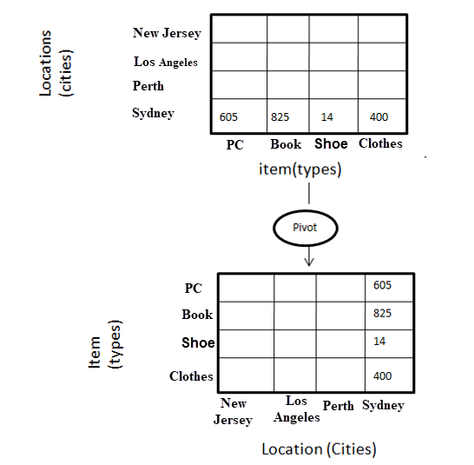

Slide 54
OLAP Operations
The analytical operations that can be performed on data cubes include:
Roll-up
Drill-down
Slice and Dice
Pivot
‹#›

Slide 55
Dimensional Operations
Roll-up performs aggregations on the data by moving up the dimensional hierarchy.
Drill-down is the reverse of roll-up and involves revealing the detailed data that forms the aggregated data.
Drill-down can be performed by moving down the dimensional hierarchy.
‹#›

Slide 56
Dimensional Operations
Slice and dice - ability to look at data from different viewpoints.
The slice operation performs a selection on one dimension of the data whereas dice uses two or more dimensions.
For example a slice of sales revenue (type = ‘Flat’) and a dice (type = ‘Flat’ and time = ‘Q1’).
‹#›

Slide 57
OLAP Operations:
Roll-up
Takes the current aggregation level of fact values and does a further aggregation on one or more of the dimensions.
Equivalent to doing GROUP BY to this dimension by using attribute hierarchy.

Slide 58
SELECT [attribute list], SUM [attribute names] FROM [table list] WHERE [condition list] GROUP BY [grouping list];

Slide 59
Drill-down
Opposite of roll-up.
Summarizes data at a lower level of a dimension hierarchy, thereby viewing data in a more specialized level within a dimension.
Increases a number of dimensions - adds new headers

Slide 60
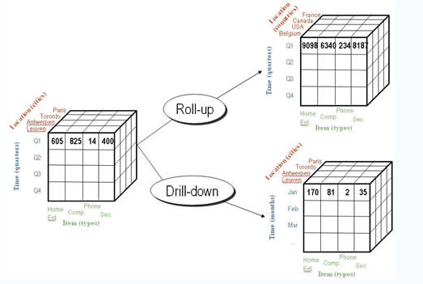

Slide 61
Slice
Performs a selection on one dimension of the given cube, resulting in a sub-cube.
Reduces the dimensionality of the cubes.
Sets one or more dimensions to specific values and keeps a subset of dimensions for selected values.
Dice
Define a sub-cube by performing a selection of one or more dimensions.
Refers to range select condition on one dimension, or to select condition on more than one dimension.
Reduces the number of member values of one or more dimensions.

Slide 62
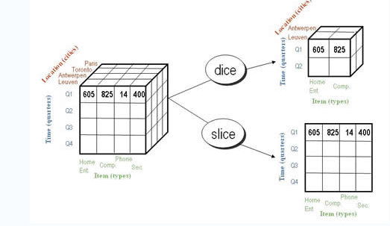

Slide 63
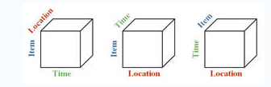
Pivot (or rotate)
Rotates the data axis to view the data from different perspectives.
Groups data with different dimensions.

Slide 64
Typical OLAP Operations
Roll up (drill-up): summarize data
by climbing up hierarchy or by dimension reduction
Drill down (roll down): reverse of roll-up
from higher level summary to lower level summary or detailed data, or introducing new dimensions
Slice and dice: project and select
Pivot (rotate):
reorient the cube, visualization, 3D to series of 2D planes
Other operations
drill across: involving (across) more than one fact table
drill through: through the bottom level of the cube to its back-end relational tables (using SQL)
Notes:
‹#›

Slide 65
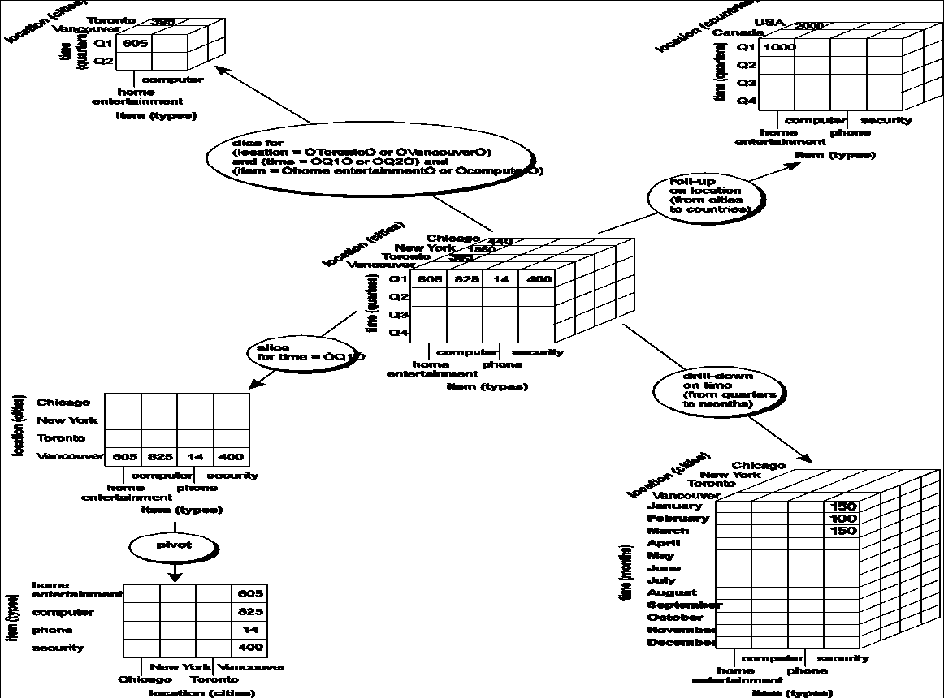
Notes:
‹#›

Slide 66
On-Line Analytical Processing
OLAP Architecture
Three Main Modules
OLAP Graphical User Interface (GUI)
OLAP Analytical Processing Logic
OLAP Data Processing Logic
Notes:
‹#›
30

Slide 67
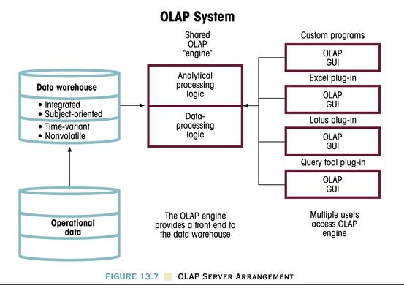
Figure 13.7 OLAP Server Arrangement
Notes:
‹#›
32

Slide 68
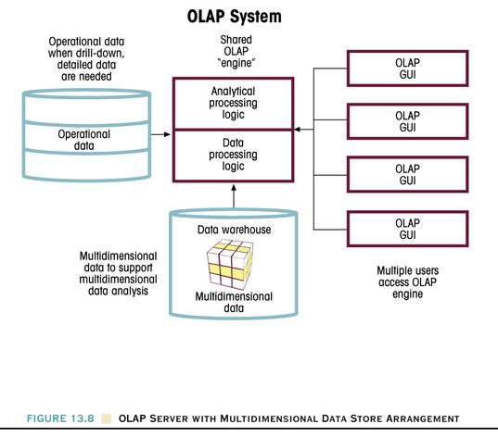
Figure 13.8 OLAP Server With Multidimensional Data Store Arrangement
Notes:
‹#›
33

Slide 69
OLAP Tools - Categories
OLAP tools are categorized according to the architecture used to store and process multi-dimensional data.
There are four main categories of OLAP tools
Multi-dimensional OLAP (MOLAP)
Relational OLAP (ROLAP)
Hybrid OLAP (HOLAP)
OLAP, by Dr. Khalil
‹#›

Slide 70
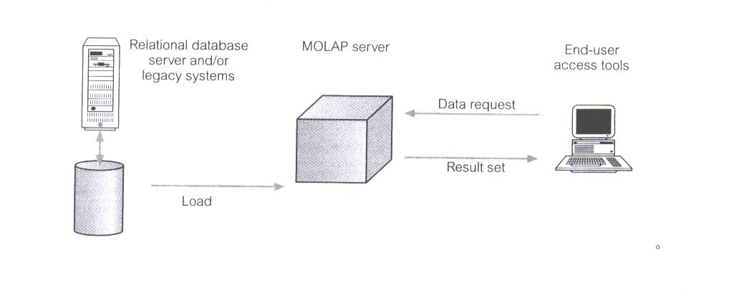
Multi-dimensional OLAP (MOLAP)
MOLAP tools use specialized data structures and multi-dimensional database management systems (MDDBMS) to organize, navigate, and analyze data.
To enhance query performance the data is typically aggregated and stored according to predicted usage.
MOLAP data structures use array technology and efficient storage techniques that minimize the disk space requirements through sparse data management.
The development issues associated with MOLAP:
Only a limited amount of data can be efficiently stored and analyzed.
Navigation and analysis of data are limited because the data is designed according to previously determined requirements.
MOLAP products require a different set of skills and tools to build and maintain the database.
OLAP, by Dr. Khalil
‹#›

Slide 71
Advantages:
Provides maximum query performance, because all the required data (a copy of the detail data and calculated aggregate data) are stored in the OLAP server itself and there is no need to refer to the underlying relational database.
All the calculations are pre-generated when the cube is processed and stored locally on the OLAP server hence even the complex calculations, as a part the query result, will be performed quickly.
MOLAP uses compression to store the data on the OLAP server and so has less storage requirements than relational databases for same amount of data.
MOLAP does not need to have a permanent connection to the underlying relational database (only at the time of processing) as it stores the detail and aggregate data in the OLAP server so the data can be viewed even when there is connection to the relational database.

Slide 72
Advantages:
With MOLAP mode, you need frequent processing to pull refreshed data after last processing resulting in drain on system resources.
Latency; just after the processing if there is any changes in the relational database it will not be reflected on the OLAP server unless re-processing is performed.
MOLAP stores a copy of the relational data at OLAP server and so requires additional investment for storage.
If the data volume is high, the cube processing can take longer, though you can use incremental processing to overcome this.

Slide 73
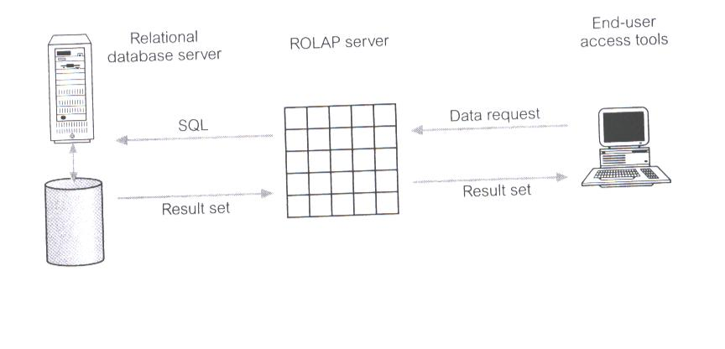
Relational OLAP (ROLAP)
ROLAP is the fastest-growing type of OLAP tools.
ROLAP supports RDBMS products through the use of a metadata layer, thus avoiding the requirement to create a static multi-dimensional data structure.
This facilitates the creation of multiple multi-dimensional views of the two-dimensional relation.
To improve performance, some ROLAP products have enhanced SQL engines to support the complexity of multi-dimensional analysis, while others recommend, or require, the use of highly denormalized database designs such as the star schema.
The development issues associated with ROLAP technology:
Performance problems associated with the processing of complex queries that require multiple passes through the relational data.
Development of middleware to facilitate the development of multi-dimensional applications.
Development of an option to create persistent multi-dimensional structures, together with facilities o assist in the administration of these structures.
OLAP, by Dr. Khalil
‹#›

Slide 74
Advantages
Ability to view the data in near real-time.
Since ROLAP does not make another copy of data as in case of MOLAP, it has less storage requirements. This is very advantageous for large datasets which are queried infrequently such as historical data.
In ROLAP mode, the detail data is stored on the underlying relational database, so there is no limitation on data size that ROLAP can support or limited by the data size of relational database. In nutshell, it can even handle huge volumes of data.

Slide 75
Disadvantages:
Compared to MOLAP or ROLAP the query response is generally slower because everything is stored on relational database and not locally on the OLAP server.
A permanent connection to the underlying database must be maintained to view the cube data.

Slide 76
Summary:
ROLAP
ROLAP works with data that exist in a relational database.
Facts and dimension tables are stored as relational tables.
It also allows multidimensional analysis of data and is the fastest growing OLAP.
Advantages of ROLAP model:
High data efficiency. It offers high data efficiency because query performance and access language are optimized particularly for the multidimensional data analysis.
Scalability. This type of OLAP system offers scalability for managing large volumes of data, and even when the data is steadily increasing.
Drawbacks of ROLAP model:
Demand for higher resources: ROLAP needs high utilization of manpower, software, and hardware resources.
Aggregately data limitations. ROLAP tools use SQL for all calculation of aggregate data. However, there are no set limits to the for handling computations.
Slow query performance. Query performance in this model is slow when compared with MOLAP

Slide 77
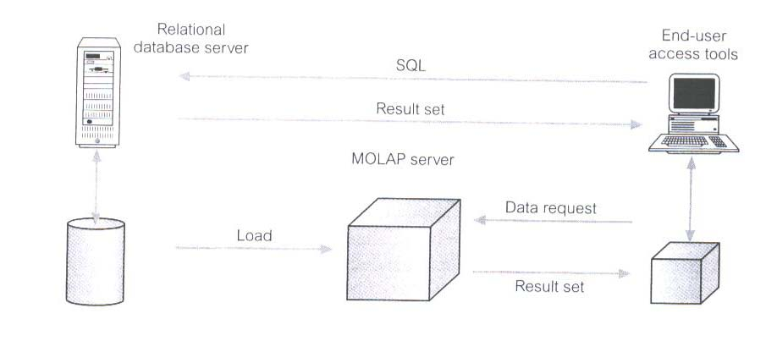
Hybrid OLAP (HOLAP)
HOLAP tools provide limited analysis capability, either directly against RDBMS products, or by using an intermediate MOLAP server.
HOLAP tools deliver selected data directly from DBMS or via MOLAP server to the desktop (or local server) in the form of data cube, where it is stored, analyzed, and maintained locally is the fastest-growing type of OLAP tools.
The issues associated with HOLAP tools:
The architecture results in significant data redundancy and may cause problems for networks that support many users.
Ability of each user to build a custom data cube may cause a lack of data consistency among users.
Only a limited amount of data can be efficiently maintained.
OLAP, by Dr. Khalil
‹#›

Slide 78
Advantages
HOLAP balances the disk space requirement, as it only stores the aggregate data on the OLAP server and the detail data remains in the relational database. So no duplicate copy of the detail data is maintained.
Since HOLAP does not store detail data on the OLAP server, the cube and partitions would be smaller in size than MOLAP cubes and partitions.
Performance is better than ROLAP as in HOLAP the summary data are stored on the OLAP server and queries can be satisfied from this summary data.
HOLAP would be optimal in the scenario where query response is required and query results are based on aggregations on large volumes of data.

Slide 79
Disadvantages:
Query performance (response time) degrades if it has to drill through the detail data from relational data store, in this case HOLAP performs very much like ROLAP.

Slide 80
Hybrid OLAP
Hybrid OLAP is a mixture of both ROLAP and MOLAP.
It offers fast computation of MOLAP and higher scalability of ROLAP. HOLAP uses two databases.
Aggregated or computed data is stored in a multidimensional OLAP cube
Detailed information is stored in a relational database.
Benefits of Hybrid OLAP:
This kind of OLAP helps to economize the disk space, and it also remains compact which helps to avoid issues related to access speed and convenience.
Hybrid HOLAP's uses cube technology which allows faster performance for all types of data.
ROLAP are instantly updated and HOLAP users have access to this real-time instantly updated data.
MOLAP brings cleaning and conversion of data thereby improving data relevance. This brings best of both worlds.
Drawbacks of Hybrid OLAP:
Greater complexity level: The major drawback in HOLAP systems is that it supports both ROLAP and MOLAP tools and applications. Thus, it is very complicated.
Potential overlaps: There are higher chances of overlapping especially into their functionalities.

Slide 81
MOLAP | ROLAP | HOLAP
MOLAP stands for Multidimensional Online Analytical Processing | ROLAP stands for Relational Online Analytical Processing | HOLAP stands for Hybrid Online Analytical Processing
The MOLAP storage mode causes the aggregations of the partition and a copy of its source data to be stored in a multidimensional structure in Analysis Services when the partition is processed. | The ROLAP storage mode causes the aggregations of the partition to be stored in indexed views in the relational database that was specified in the partition’s data source. | The HOLAP storage mode combines attributes of both MOLAP and ROLAP. Like MOLAP, HOLAP causes the aggregations of the partition to be stored in a multidimensional structure in an SQL Server Analysis Services instance.
This MOLAP structure is highly optimized to maximize query performance. The storage location can be on the computer where the partition is defined or on another computer running Analysis Services. Because a copy of the source data resides in the multidimensional structure, queries can be resolved without accessing the partition’s source data. | Unlike the MOLAP storage mode, ROLAP does not cause a copy of the source data to be stored in the Analysis Services data folders. Instead, when results cannot be derived from the query cache, the indexed views in the data source are accessed to answer queries. | HOLAP does not cause a copy of the source data to be stored. For queries that access only summary data in the aggregations of a partition, HOLAP is the equivalent of MOLAP.

Slide 82
Query response times can be decreased substantially by using aggregations. The data in the partition’s MOLAP structure is only as current as the most recent processing of the partition. | Query response is generally slower with ROLAP storage than with the MOLAP or HOLAP storage modes. Processing time is also typically slower with ROLAP. However, ROLAP enables users to view data in real time and can save storage space when you are working with large datasets that are infrequently queried, such as purely historical data. | Queries that access source data—for example, if you want to drill down to an atomic cube cell for which there is no aggregation data—must retrieve data from the relational database and will not be as fast as they would be if the source data were stored in the MOLAP structure. With HOLAP storage mode, users will typically experience substantial differences in query times depending upon whether the query can be resolved from cache or aggregations versus from the source data itself.

Slide 83
Advantages of OLAP
OLAP is a platform for all type of business includes planning, budgeting, reporting, and analysis.
Information and calculations are consistent in an OLAP cube. This is a crucial benefit.
Quickly create and analyze "What if" scenarios
Easily search OLAP database for broad or specific terms.
OLAP provides the building blocks for business modeling tools, Data mining tools, performance reporting tools.
Allows users to do slice and dice cube data all by various dimensions, measures, and filters.
It is good for analyzing time series.
Finding some clusters and outliers is easy with OLAP.
It is a powerful visualization online analytical process system which provides faster response times

Slide 84
Disadvantages of OLAP
OLAP requires organizing data into a star or snowflake schema. These schemas are complicated to implement and administer
You cannot have large number of dimensions in a single OLAP cube
Transactional data cannot be accessed with OLAP system.
Any modification in an OLAP cube needs a full update of the cube. This is a time-consuming process

Slide 85
OLAP Tools:
1)IBM Cognos
2)Microsoft SQL server Analysis Services
3)Apache Kylin
4)Pentaho BI
5) Phpmyolap

Slide 86
Summary:
OLAP is a technology that enables analysts to extract and view business data from different points of view.
At the core of the OLAP, the concept is an OLAP Cube.
Various business applications and other data operations require the use of OLAP Cube.
There are primary five types of analytical operations in OLAP 1) Roll-up 2) Drill-down 3) Slice 4) Dice and 5) Pivot
Three types of widely used OLAP systems are MOLAP, ROLAP, and Hybrid OLAP.

Slide 87
On-Line Analytical Processing
OLAP Architecture
Three Main Modules
OLAP Graphical User Interface (GUI)
OLAP Analytical Processing Logic
OLAP Data Processing Logic
OLAP systems are designed to use both operational and Data Warehouse data.
Notes:
‹#›
30

Slide 88
Figure 13.7 OLAP Server Arrangement
Notes:
‹#›
32

Slide 89
Figure 13.8 OLAP Server With Multidimensional Data Store Arrangement
Notes:
‹#›
33

Slide 90
OLAP Cube
OLAP Cube Definition
An OLAP Cube is a data structure that allows fast analysis of data according to the multipleDimensions that define a business problem. A multidimensional cube for reporting sales might be, for example, composed of 7 Dimensions: Salesperson, Sales Amount, Region, Product, Region, Month, Year.

Slide 91
OLAP Operations:
Roll-up
Takes the current aggregation level of fact values and does a further aggregation on one or more of the dimensions.
Equivalent to doing GROUP BY to this dimension by using attribute hierarchy.

Slide 92
SELECT [attribute list], SUM [attribute names] FROM [table list] WHERE [condition list] GROUP BY [grouping list];

Slide 93
Drill-down
Opposite of roll-up.
Summarizes data at a lower level of a dimension hierarchy, thereby viewing data in a more specialized level within a dimension.
Increases a number of dimensions - adds new headers

Slide 95
Slice
Performs a selection on one dimension of the given cube, resulting in a sub-cube.
Reduces the dimensionality of the cubes.
Sets one or more dimensions to specific values and keeps a subset of dimensions for selected values.
Dice
Define a sub-cube by performing a selection of one or more dimensions.
Refers to range select condition on one dimension, or to select condition on more than one dimension.
Reduces the number of member values of one or more dimensions.

Slide 97
Pivot (or rotate)
Rotates the data axis to view the data from different perspectives.
Groups data with different dimensions.

Slide 98
Advantages of ROLAP Dimensional Modeling
Define complex, multi-dimensional data with simple model
Reduces the number of joins a query has to process
Allows the data warehouse to evolve with rel. low maintenance
HOWEVER! Star schema and relational DBMS are not the magic solution
Query optimization is still problematic

Slide 99
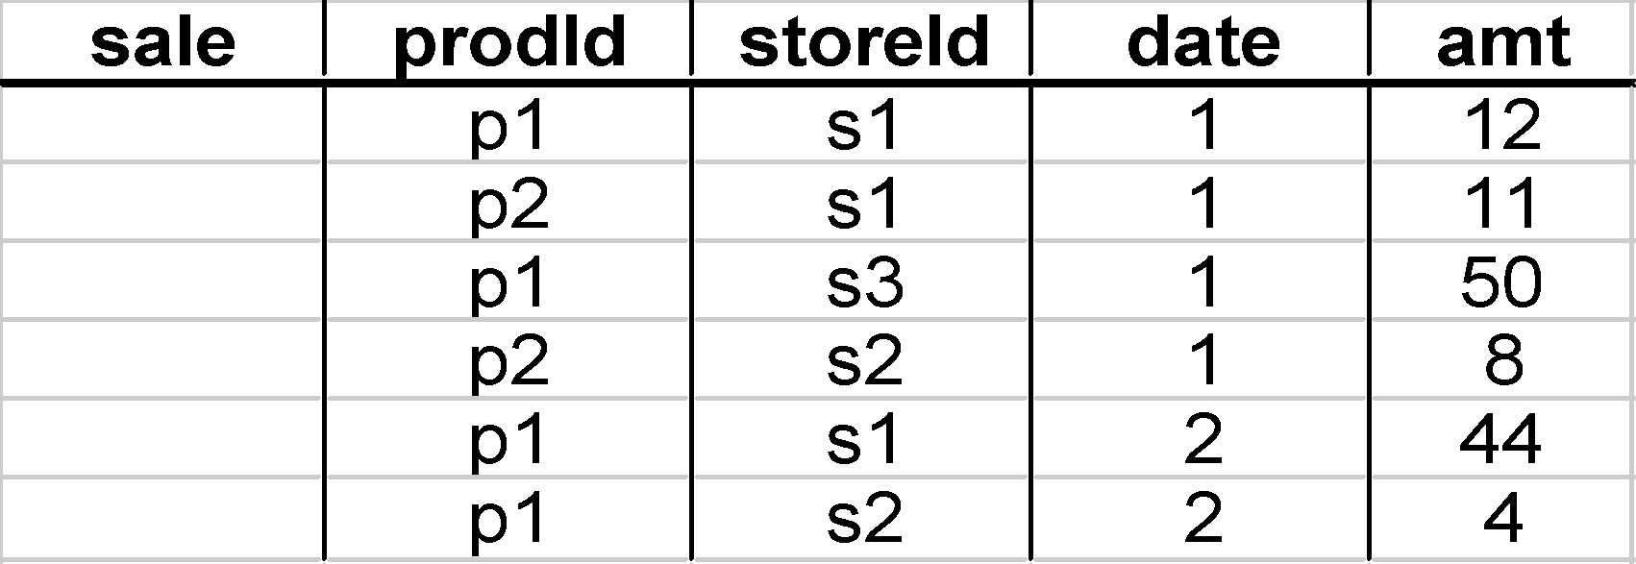
Aggregates
Add up amounts for day 1
In SQL: SELECT sum(amt) FROM SALE
WHERE date = 1
81

Slide 100
Aggregates
Add up amounts by day
In SQL: SELECT date, sum(amt) FROM SALE
GROUP BY date

Slide 101
Another Example
Add up amounts by day, product
In SQL: SELECT date, sum(amt) FROM SALE
GROUP BY date, prodId
rollup
drill-down

Slide 102
Aggregates
Operators: sum, count, max, min, median, ave
“Having” clause
Using dimension hierarchy
average by region (within store)
maximum by month (within date)

Slide 103
ROLAP vs. MOLAP
ROLAP: Relational On-Line Analytical Processing
MOLAP: Multi-Dimensional On-Line Analytical Processing

Slide 104


The MOLAP Cube
Fact table view:
Multi-dimensional cube:
dimensions = 2

Slide 105


3-D Cube
Fact table view:
Multi-dimensional cube:
day 2
day 1
dimensions = 3

Slide 106
Example
roll-up to region
Dimensions:
Time, Product, Store
Attributes:
Product (upc, price, …)
Store …
…
Hierarchies:
Product → Brand → …
Day → Week → Quarter
Store → Region → Country
NY
Store
SF
roll-up to brand
LA
Juice
Milk
Coke
Cream
Soap
Bread
10
34
56
32
12
56
Product
roll-up to week
M T W Th F S S
Time
56 units of bread sold in LA on M

Slide 107


Cube Aggregation: Roll-up
Example: computing sums
day 2
. . .
day 1
129
rollup
drill-down

Slide 108
Cube Operators for Roll-up
day 2
. . .
day 1
sale(s1,*,*)
129
sale(s2,p2,*)
sale(*,*,*)

Slide 109



Extended Cube
*
day 2
sale(*,p2,*)
day 1

Slide 110
Aggregation Using Hierarchies
day 2
store
day 1
region
country
(store s1 in Region A;
stores s2, s3 in Region B)

Slide 111
Slicing
day 2
day 1
TIME = day 1

Slide 112

Slicing &
Pivoting

